Slide 1
Smartphone Recommendation System
Applied Research Project A
Prof. Dr. Timo Kahl
Presented by
Bhuwan Acharya (26129)
Bikash Paudel (26192)
Sudarshan Awasthi (26558)
Md. Monsur Ali (24547)
Anup Katuwal (26557)
Musifique Ahmed Isha (26532)

Slide 2
Agenda
Introduction
Methodology
Result
Conclusion
Outlook

Slide 3
INTRODUCTION
Smartphones are becoming integral part of people’s lives. (Transportation, Shopping, Banking and many more)
According to Statista, a leading german statistics company
Approximately, 2.7 billion people are using smartphone in current year and numbers are increasing rapidly
In 2018, around 1.56 billion smartphones were sold globally
More than 115 smartphone brands are available in 2019
More than 80% are Android Operating System based
About 15% are iOS Operating System based
5% others
Samsung, Apple and Huawei are the top 3 smartphone vendors
Notes:
39% of world’s population
For transportation, shopping, banking,

Slide 4
Trends of buying smartphone
Brand and service providers has major impact
Design, Computing power, Operating platform, and Price
consumers’ usage behaviors such as using smartphone for email, web browsing, gaming, and document reading
People have different aspect to buy different smartphone
Many options on smartphone creates complexity for people to buy one
Many smartphones has similar features of different price
Some are dedicated to some special features(Camera, Sound, Processor)
After purchasing smartphone, Many doesn’t satisfy
Need to change smartphone frequently

Slide 5
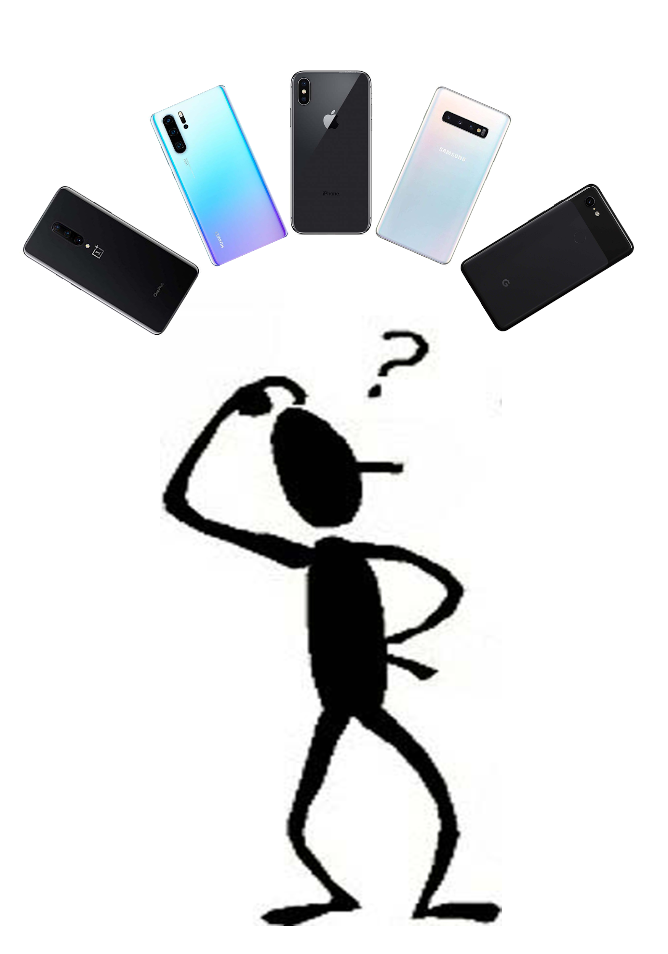

Slide 6
Recommendation System
Computer-aided decision systems are needed to assist users to meet their preferences
Only few mobile usability studies have been applied till date
Some of them are:
Clustering based recommendation systems
iterative clustering method that uses the interrelationships between users and objects
Combinatorial vote
Group of voters express their preferences and finally they come to a common decision
Intelligence system has not been well implemented for recommendation

Slide 7
PROBLEM STATEMENT
Many factors, features, and criteria must be considered for better decision making and not much such system are available
Very less research has been conducted in this field
Lack of Intelligent system for recommendation of smartphone

Slide 8
Aim
To build the intelligent system considering different aspects such as age, gender,annual income, willing to pay amount, profession , feature usage and purpose of using smartphone for assisting users to make better and intelligent choice of smartphone

Slide 9
Data Collection

Slide 10
Data Collection
A questionnaire was created using google forms and an online survey was conducted
The questionnaire was divided into of 3 sections:
Personal Section :
for the collecting data like age, gender, willing amount, annual income and profession
Smartphone Section :
To collect data such as which smartphone model they use, major reason for using smart phone and their feature preferences
Consumer Influences Section :
To collect data regarding whether people purchase smartphones based on personal research or just based on social influence
The total of 368 responses were recorded

Slide 11
Data Preprocessing
Real-world data is often incomplete and inconsistent, generally contains many error
Extraction of inappropriate data from our collected data involved following steps:
Data cleaning
Data integration
Data transformation
Data reduction
Data discretization

Slide 12
Visualization

Slide 13
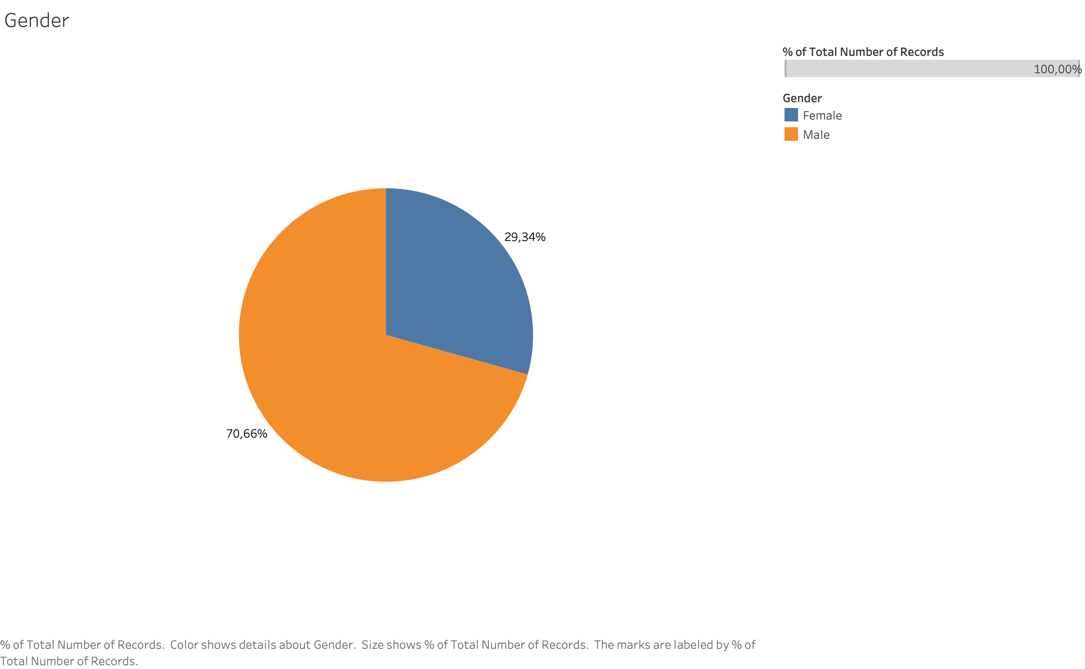
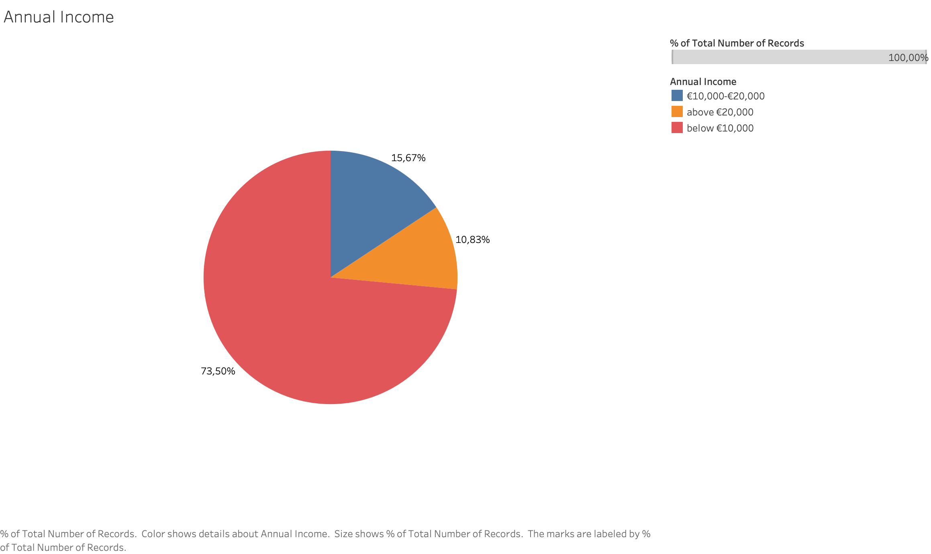
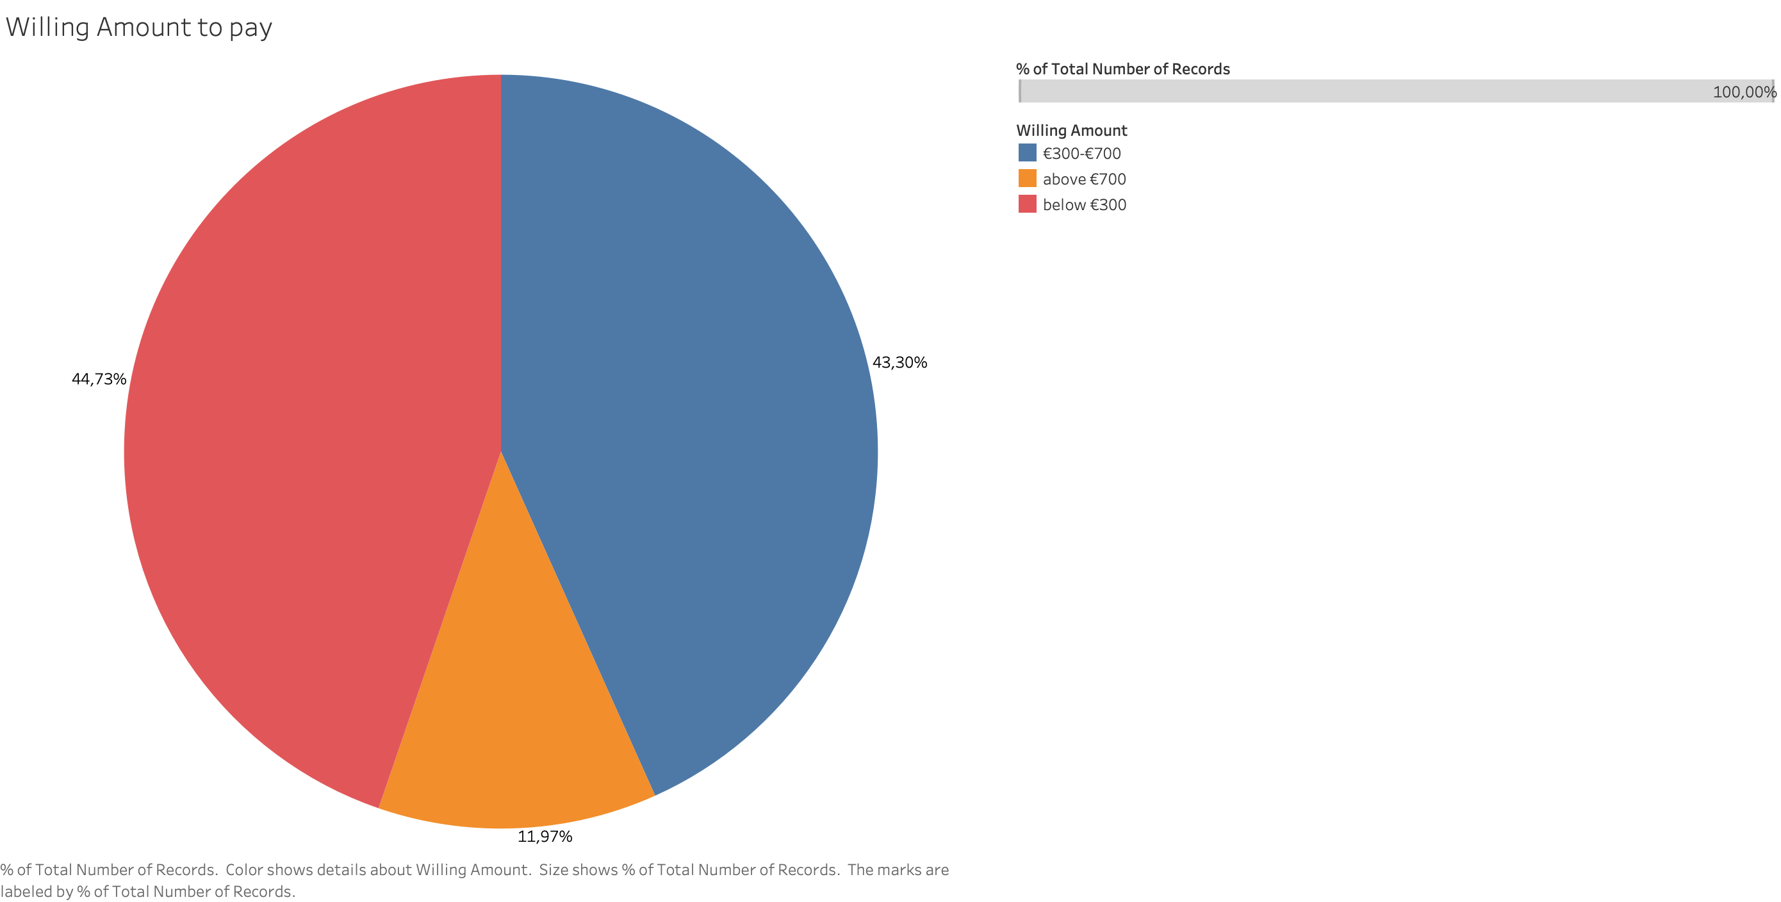
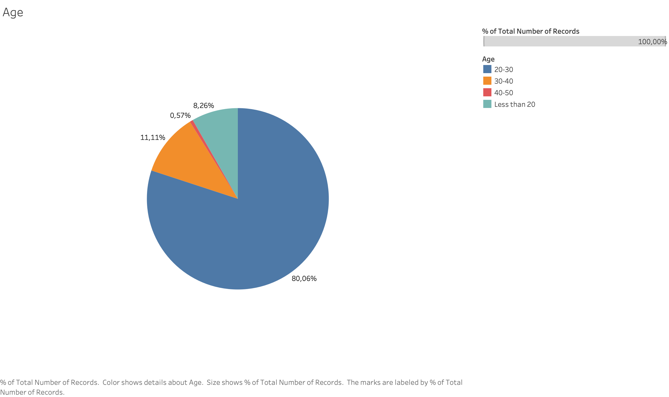
General Survey Data

Slide 14
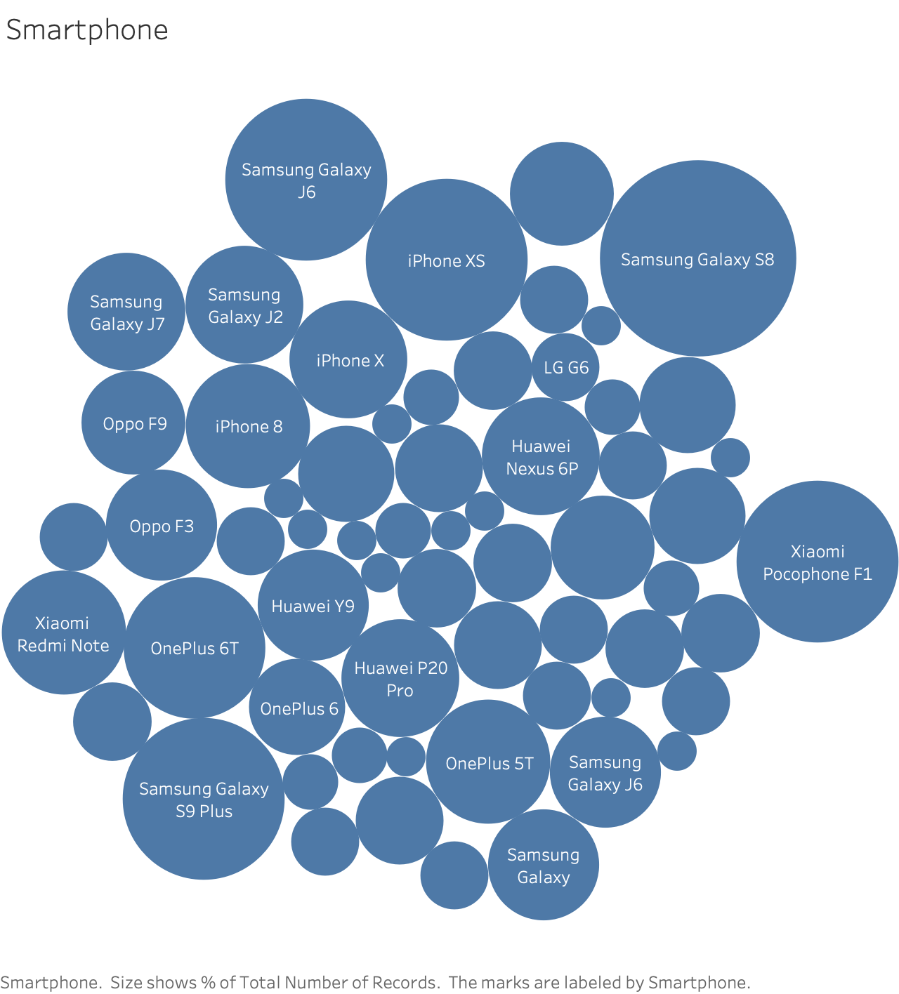
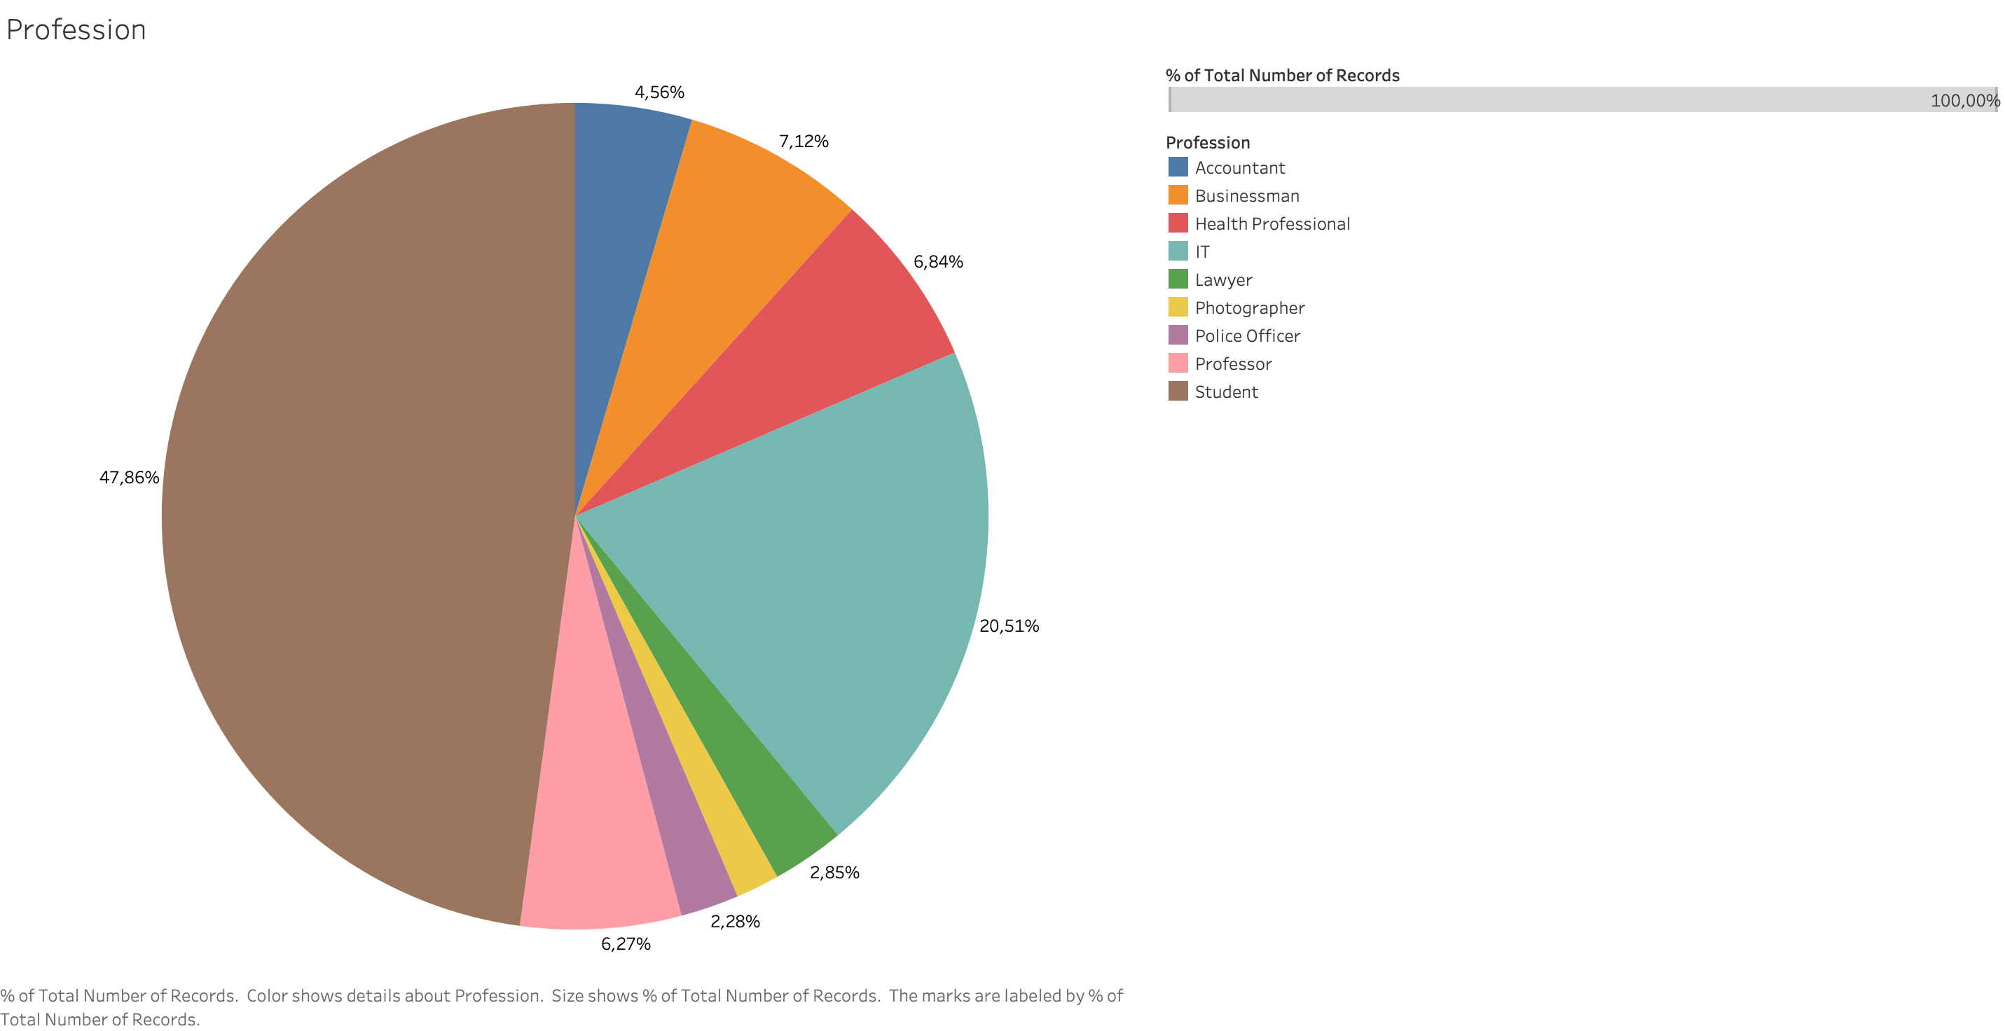
General Survey Data

Slide 15
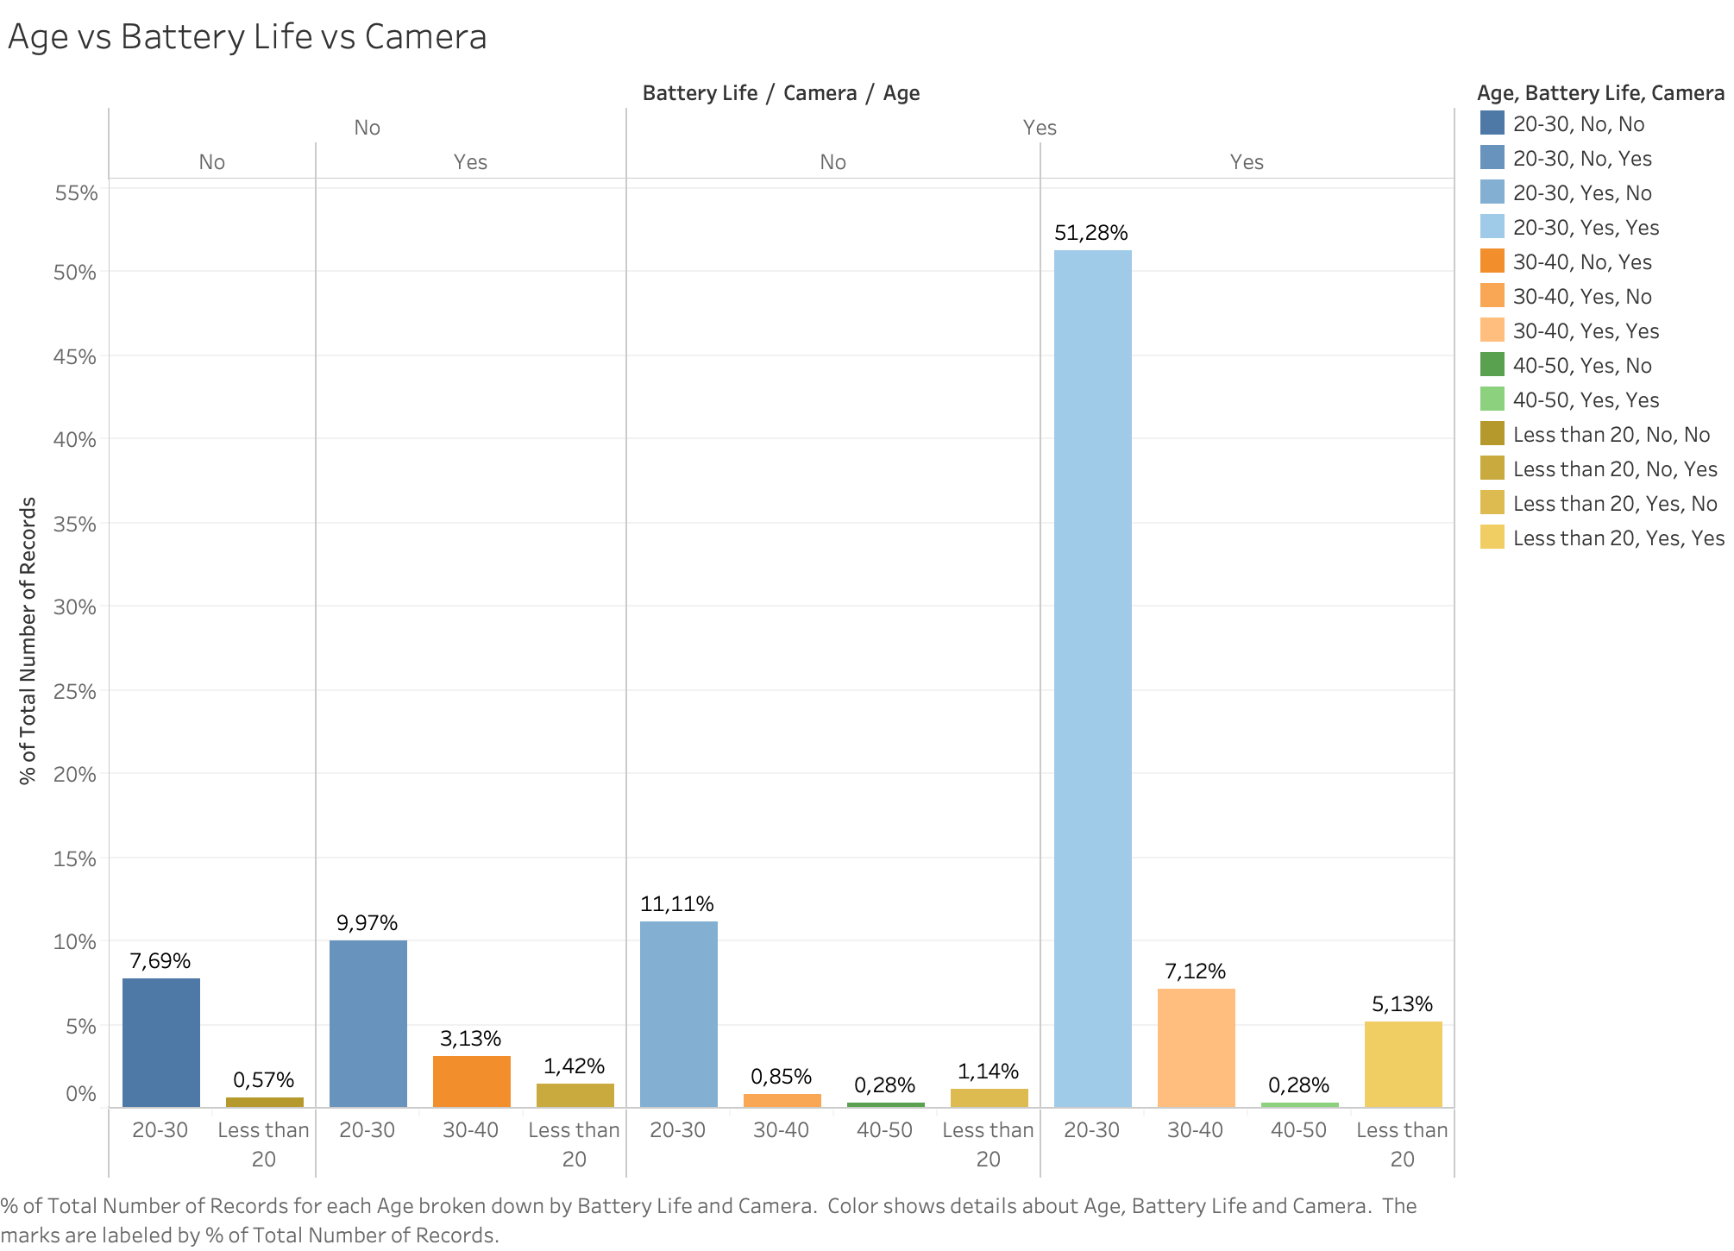
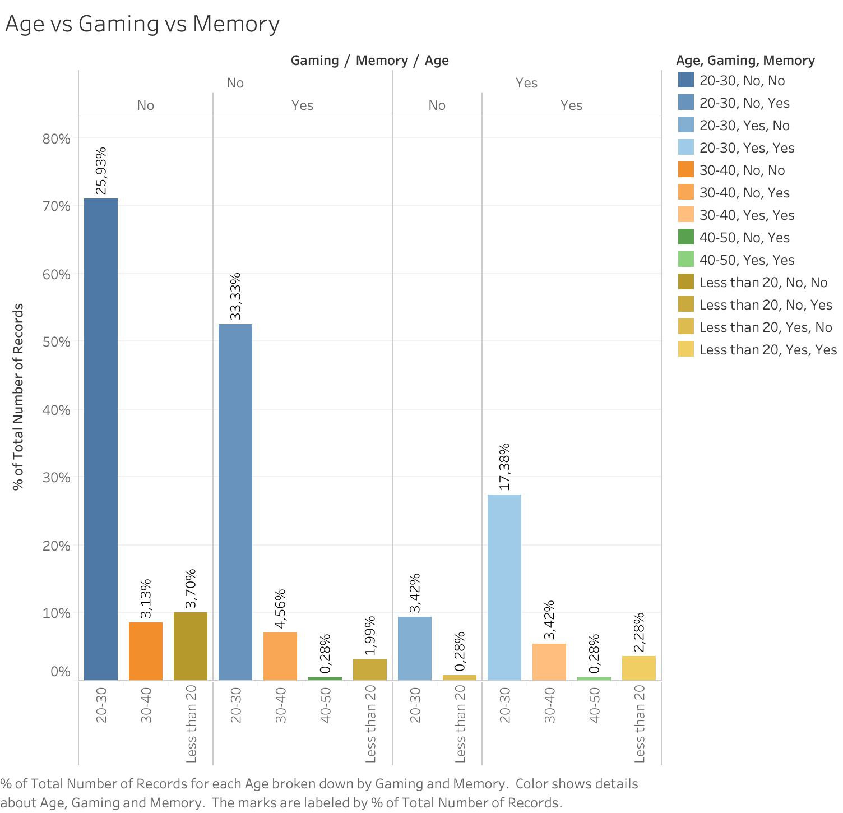
Visualization

Slide 16
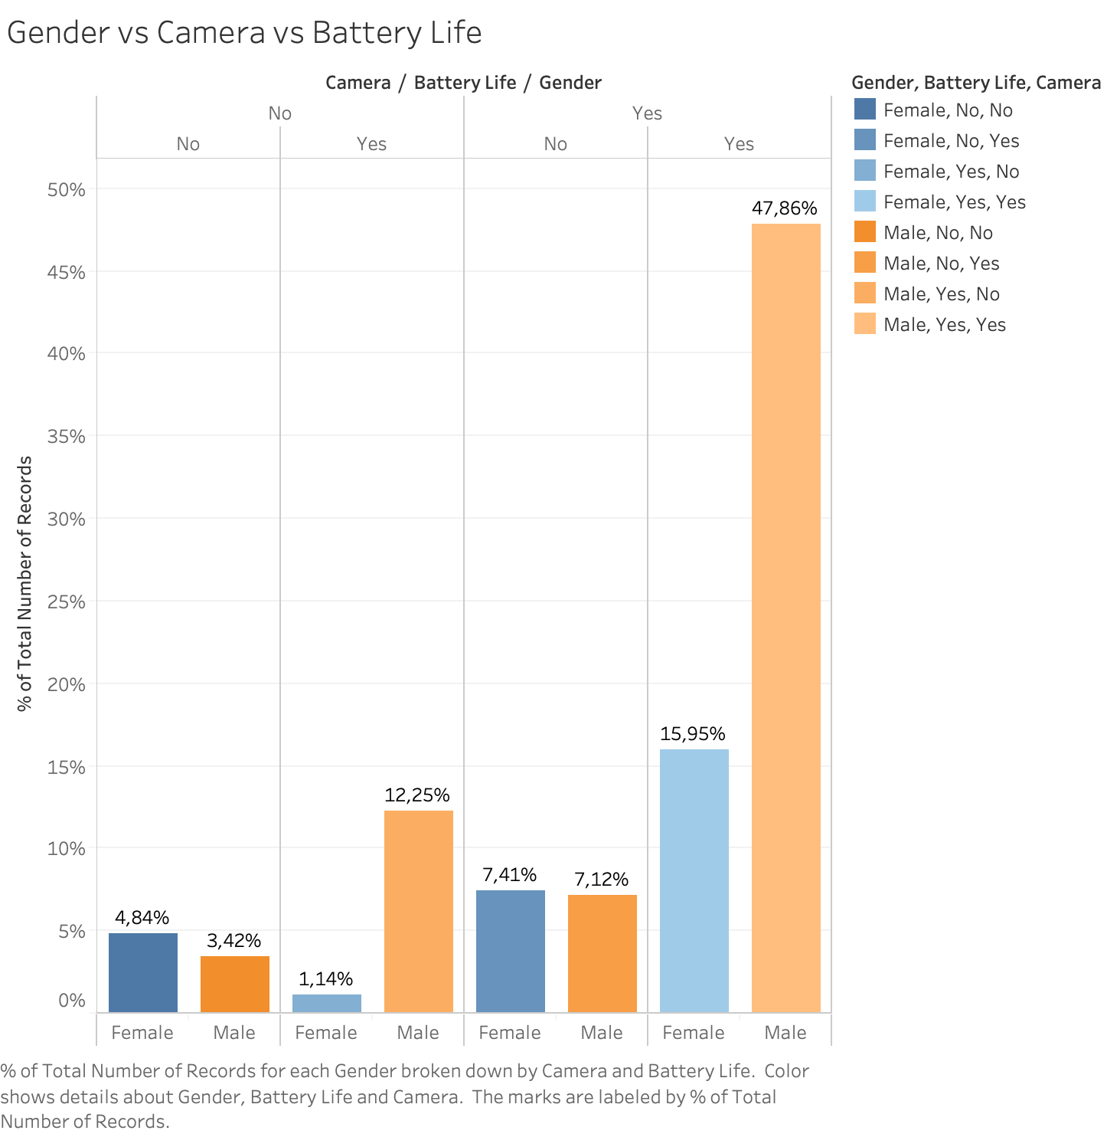
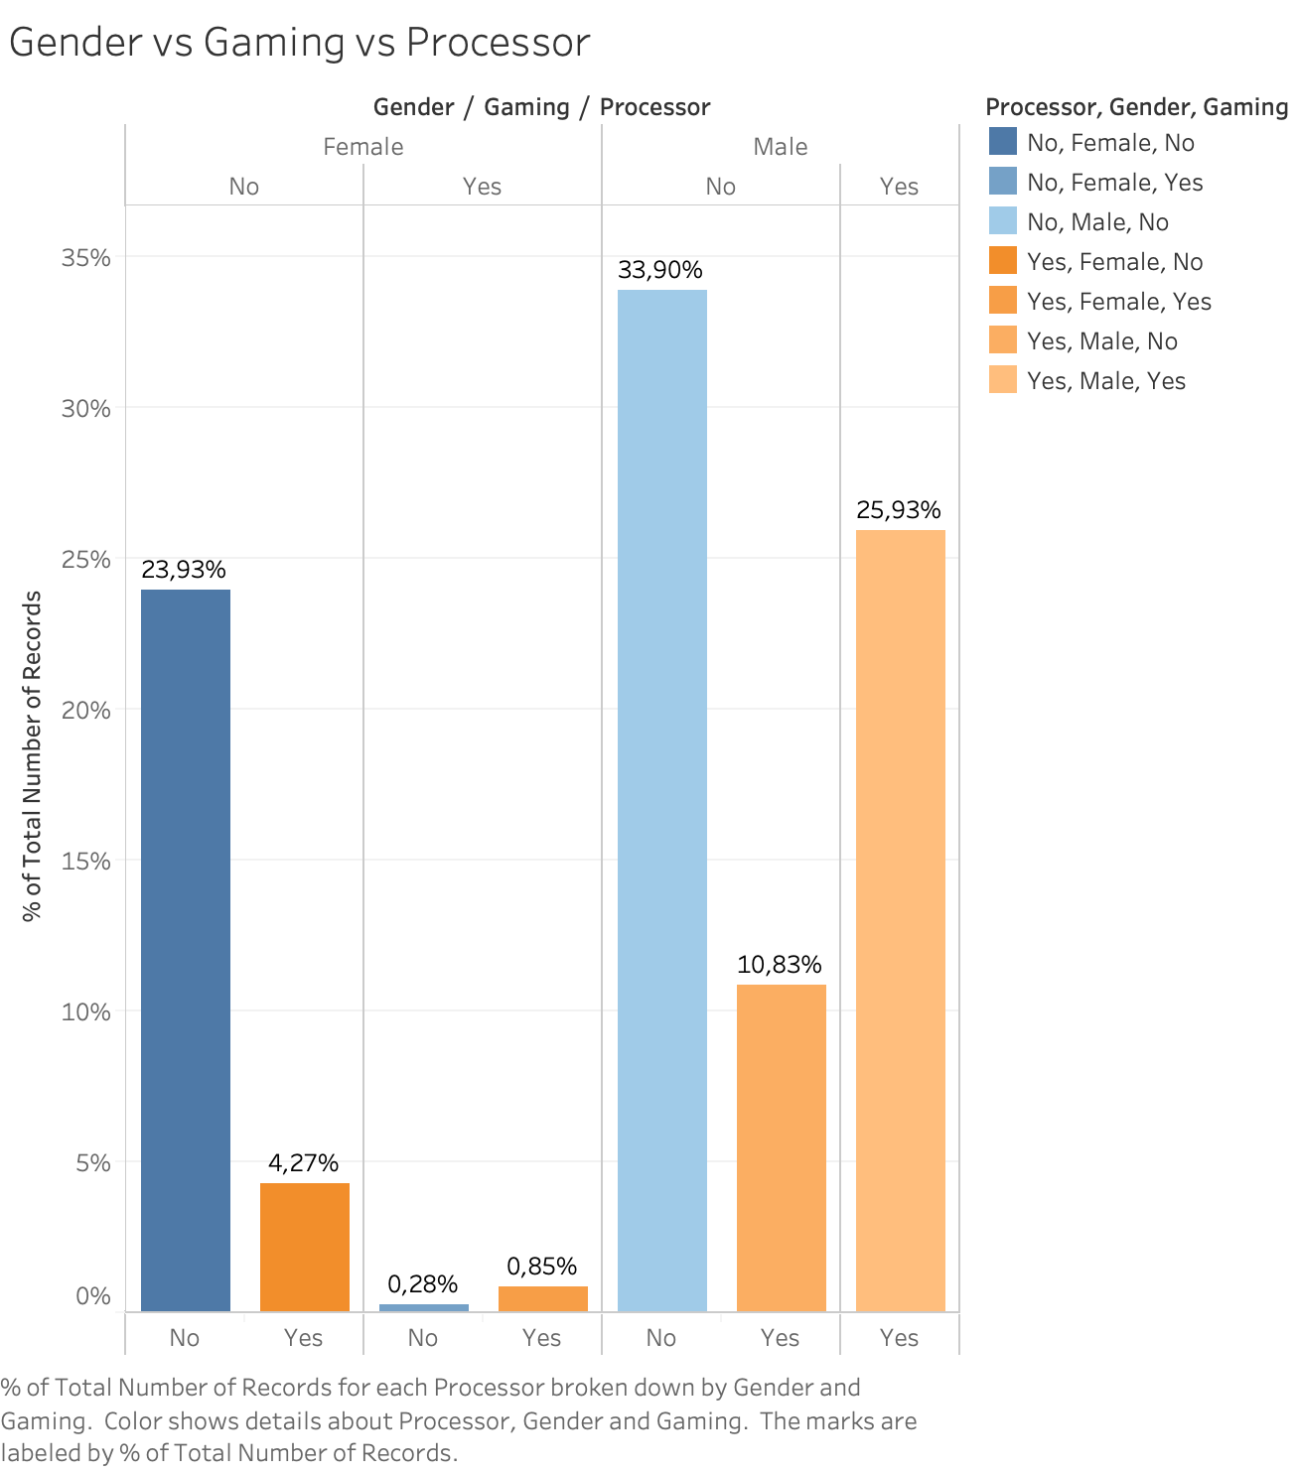
Visualization

Slide 17
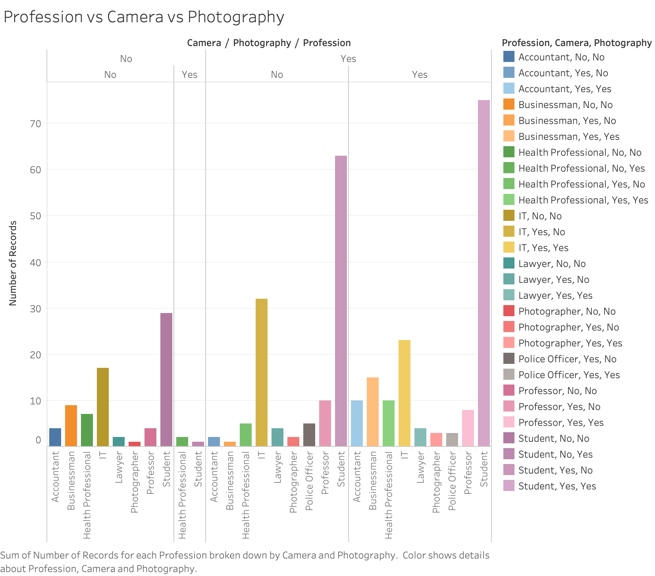
Visualization

Slide 18
Website Overview

Slide 19
Website Design
Front End
HTML
CSS
Bootstrap
Javascript
Font Awesome
Back End
Flask
Notes:
HTML:
Hyper Text Markup Language
For developing Web Pages and Apps it is used as the standard markup language
After reading the .html file, the content is rendered by the browser and then we can view it
CSS:
Cascading Style Sheets
The presentation of a markup language document like HTML is described by CSS
Describes the rendering of HTML element on screen
One CSS file can control the layout of multiple web pages
The element is selected by a selector in HTML and then the CSS rule is applied on that element
Bootstrap:
Bootstrap is a HTML, CSS and JavaScript framework for creating responsive web pages.
It contains HTML and CSS-based design templates for typography, forms, buttons, navigation and other interface components, as well as optional JavaScript extensions.
It helps to speed up development time while maintaining the consistency and quality across the site.
JavaScript:
Prototype based dynamic, object oriented programming language
It programs the behavior of web pages
Font Awesome:
It provides icons to web page
Flask: Flask is a micro web framework based on Python. It is a popular Python web development framework.
Input will be given by user
Then the input will be pushed into the server
Evaluation of Input
After evaluation the output will be shown from server to web page
Our website contains several tabs like Home, abouts us, contacts,visualization and recommendation
Visualization page shows the result of survey data
Recommendation page has a input form
Several questions are asked for the input for our recommendation system
Flask is used to handle this inputs
Push method sends data to the server
In python, Data is fetched from the server and feeded to the recommendation system
Based on those input data our recommendation system predicts the Smartphone
ANN(Artificial Neural Network) is used to create model
It recommend a single phone
On the basis of that phone, four other alternative phones are also recommended
Specification of all those recommended phones are displayed so that it is easier to compare for the user

Slide 20
Website Overview
Home Page
About Us
Our Services
Our Team
Contact Us
Data Visualization
Recommendation Input Page
Recommendation Output Page

Slide 21
User Inputs for Recommendation

Slide 22
Division of Inputs
Divided into three parts:
Personal Information
Personal Preference
Features

Slide 23
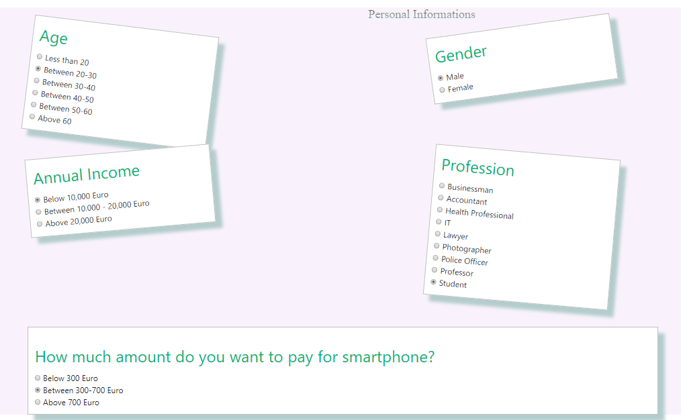
Personal Information Input

Slide 24
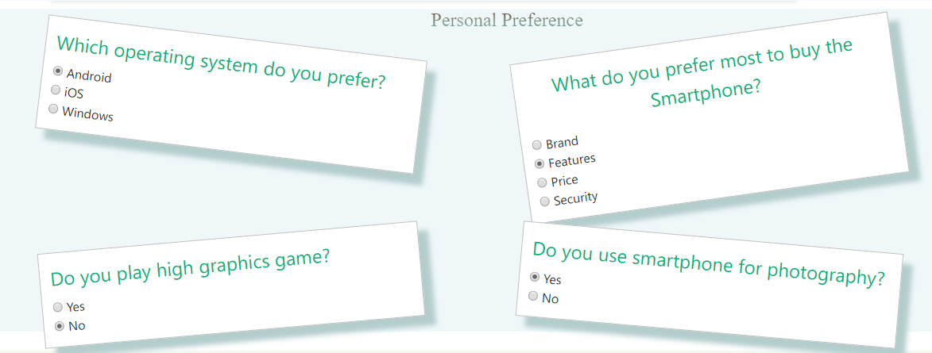
Personal Preference Input

Slide 25
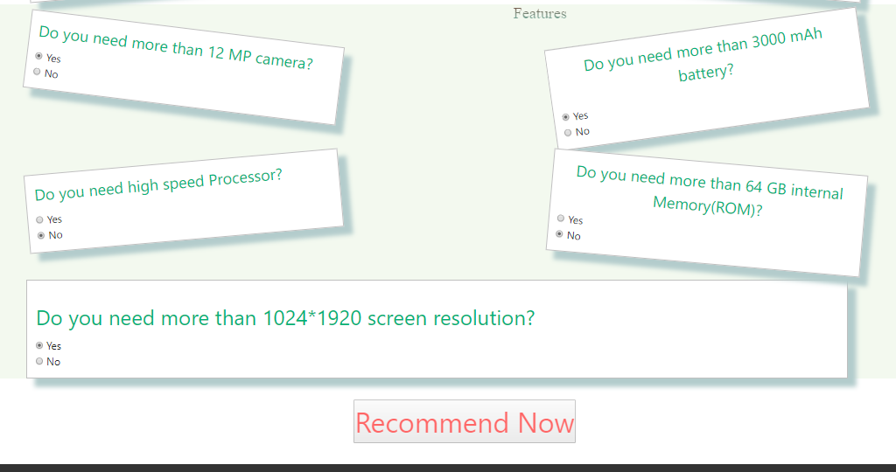
Features Input

Slide 26
Recommendation System

Slide 27
Tools used for recommendation system
Language: Python
Libraries:
Pandas
Keras with Tensorflow back-end
Numpy
Sklearn

Slide 28
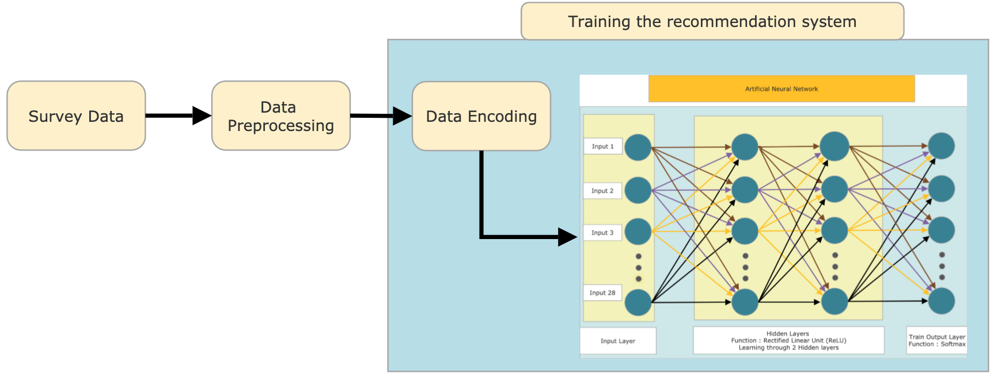
Recommendation System Training Architecture

Slide 29
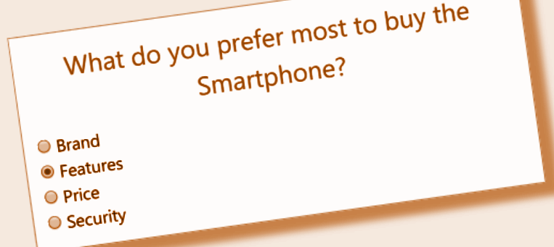
Data Encoding Concept
Sample
Encoding
Brand 001
Feature 010
Price 100
Security 000

Slide 30
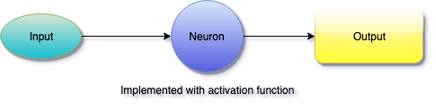
Artificial Neuron
Activation Function :
In general, it is a mathematical function associated with an artificial neural node.

Slide 31
Layers in Artificial Neural Network
Input Layer
Collection of input nodes which provides information from the outside world to the network
No calculation is performed in any of the Input .
Output Layer
Collection of nodes responsible for final calculation
transferring information from the network to the outside world.
Hidden Layer

Slide 32
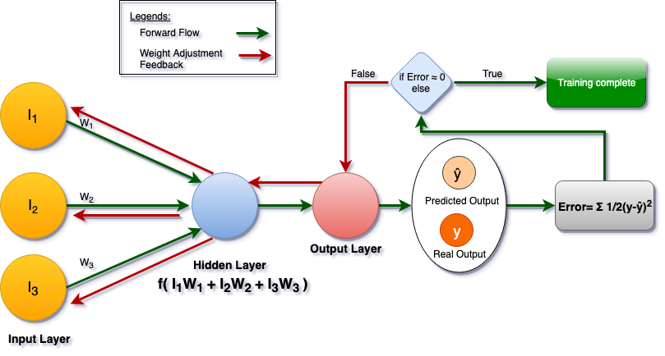
How Neural Networks Learn?

Slide 33
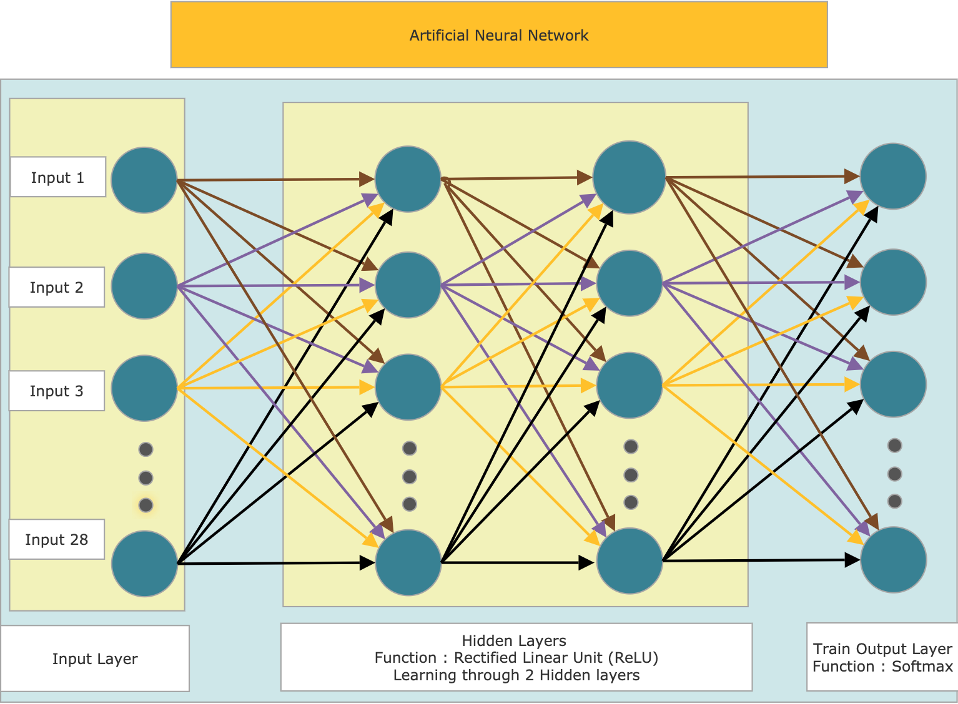
Architecture

Slide 34
Database

Slide 35

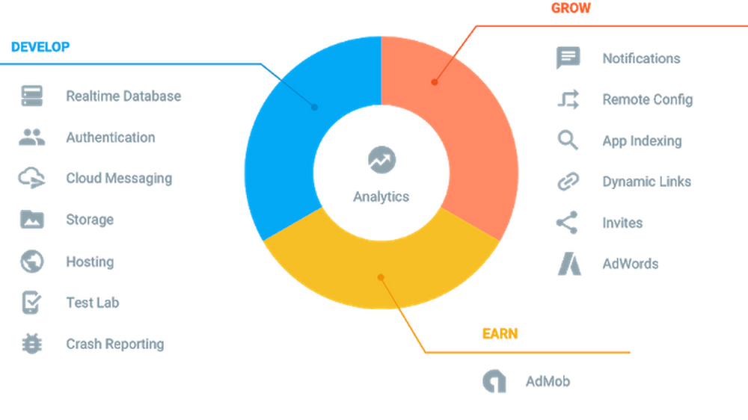
Database
Firebase Realtime Database
Cloud-hosted NoSQL database
Store and sync data in realtime
Image Source: Fan, Alex. “How Using Firebase Can Help You Earn More.” Google, Google, 8 Nov. 2016, www.blog.google/products/admob/how-using-firebase-can-help-you-earn-more/.

Slide 36
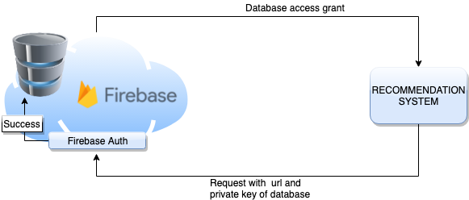
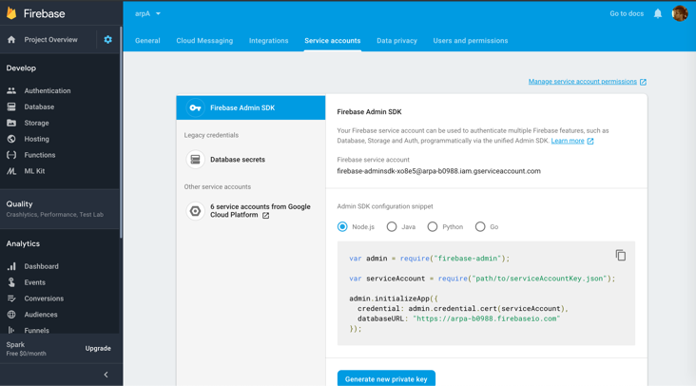
Authentication and Data Access from Firebase Database

Slide 37
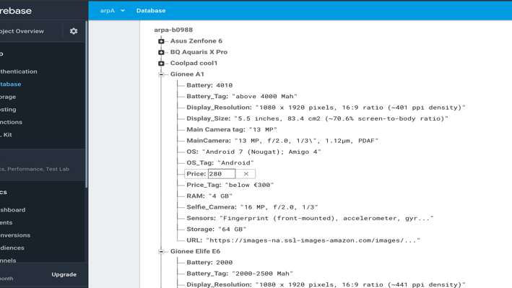
Database Structure
JSON Database Structure
On JSON, smartphone name is considered object of hash and specification as key value pair

Slide 38
Pros and Cons of Firebase database
Pros:
Easy access to real time data and authentication
No server infrastructure needed
Massive storage size potential
Cons:
With Free version:
Authentication: 10k/month
Storage: 1 GB
Simultaneous connections: 100

Slide 39
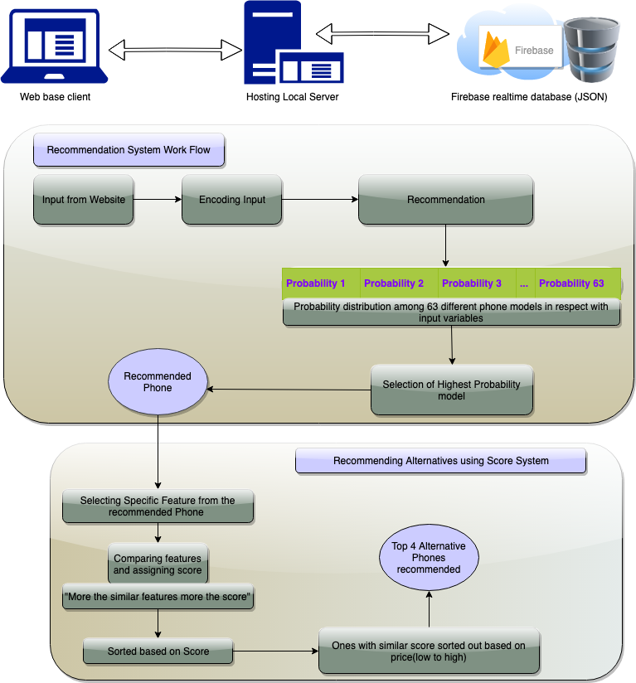
Recommendation System Workflow After Website Integration

Slide 40
Output

Slide 41
Conclusion
Intelligent system considering different factors, functions and criteria has been successfully implemented.

Slide 42
Limitations
Due to insufficient survey data
Recommendation system was trained on less data, may lead to some inaccuracies
Limited outputs

Slide 43
Future Goals
Host it into the global server
High volume survey data to increase accuracy

Slide 44
Works Cited
Holst, Arne. “Number of Smartphones Sold to End Users Worldwide from 2007 to 2018 (in Million Units).” https://Www.statista.com/Statistics/263437/Global-Smartphone-Sales-to-End-Users-since-2007/, Www.Statista.com. Accessed 4th July, 2019.
Prof. P. Govindarajulu, and Mr. Y. Subba Reddy. A Mobile Phone Recommendation System with User Centric Voting Approach, 18 , no. 2, ser. 91-102, Feb. 2018. 91-102, paper.ijcsns.org/07_book/201802/20180212.pdf.
“Documentation.” Google, Google, firebase.google.com/docs.Fan, Alex. “How Using Firebase Can Help You Earn More.” Google, Google, 8 Nov. 2016, www.blog.google/products/admob/how-using-firebase-can-help-you-earn-more/.
Hanumanthappa , Uma k,M. “Data Collection Methods and Data Preprocessing Techniques for Healthcare Data Using Data Mining”. International Journal of Scientific & Engineering Research Volume 8, Issue 6, June-2017 1131 ISSN 2229-5518. June 2007, www.ijser.org/researchpaper/Data-Collection-Methods-and-Data-Pre-processing-Techniques-for-Healthcare-Data-Using-Data-Mining.pdf. Accessed 4th July, 2019.

